Slide 1

Chapter 8
Switching

Slide 2

Switching
Switching
  Switches are devices capable of creating temporary connections between two or more devices linked to the switch.

Slide 3

Switching
Figure 8.2 Taxonomy of switched networks

Slide 4
8-1 CIRCUIT-SWITCHED NETWORKS
A circuit-switched network consists of a set of switches connected by physical links. A connection between two stations is a dedicated path made of one or more links. However, each connection uses only one dedicated channel on each link. Each link is normally divided into n channels by using FDM or TDM.
Topics discussed in this section:
Three Phases
Efficiency
Delay
Circuit-Switched Technology in Telephone Networks

Slide 5

Figure 8.3 A trivial circuit-switched network

Slide 6
A trivial circuit-switched network
When end system A needs to communicate with sys. M
  Setup Phase ; System A needs to request a connection to M that must be accepted by all switches as well as by M itself.
    A channel is reserved on each link, and the combination of channels defines the dedicated path.
  Data transfer ; After the dedicated path made of connected channels is established, data transfer can take place.
  Teardown Phase ; After all data have been transferred, the circuits are torn down.

Slide 7

Note
In circuit switching, the resources need to be reserved during the setup phase;
the resources remain dedicated for the entire duration of data transfer until the teardown phase.

Slide 8
Efficiency & delay
Efficiency
  Circuit switched networks are not as efficient as the other two types of networks because resources are allocated during the entire duration of the connection.
  These resources are unavailable to other connections.
Delay
  Although a circuit-switched network normally has low efficiency, the delay in this type of network is minimal.
  During data transfer the data are not delayed at each switch; the resources are allocated for the duration of the connection.

Slide 9

Figure 8.6 Delay in a circuit-switched network

Slide 10
Note
Switching at the physical layer in the traditional telephone network uses
the circuit-switching approach.

Slide 11
8-2 DATAGRAM NETWORKS
In data communications, we need to send messages from one end system to another. If the message is going to pass through a packet-switched network, it needs to be divided into packets of fixed or variable size. The size of the packet is determined by the network and the governing protocol.
Topics discussed in this section:
Routing Table
Efficiency
Delay
Datagram Networks in the Internet

Slide 12
Note
In a packet-switched network, there
is no resource reservation;
resources are allocated on demand.

Slide 13

Datagram network
In datagram network, each packet is treated independently of all others.
  Even if a packet is part of a multipacket transmission, the network treats it as though it existed alone.
Figure 8.7 A datagram network with four switches (router)

Slide 14

Routing table
Figure 8.8 Routing table in a datagram network
A switch in a datagram network uses a routing table that is based on the destination address.

Slide 15
Note
The destination address in the header of a packet in a datagram network
remains the same during the entire journey of the packet.
The efficiency of a datagram network is better than that of a circuit-switched network; resources are allocated only when there are packets to be transferred.

Slide 16

Delay
There may be greater delay in a datagram network than in a
virtual-circuit network.
  Total delay = 3T + 3זּ+ w₁ + w₂
  Where, T=Transmission time, זּ =Propagation delay, w=Waiting time
Figure 8.9 Delay in a datagram network

Slide 17
Note
Switching in the Internet is done by using the datagram approach
to packet switching at
the network layer.

Slide 18
8-3 VIRTUAL-CIRCUIT NETWORKS
A virtual-circuit network is a cross between a circuit-switched network and a datagram network. It has some characteristics of both.
Topics discussed in this section:
Addressing
Three Phases
Efficiency
Delay
Circuit-Switched Technology in WANs

Slide 19
Virtual-Circuit Network
Characteristics of Virtual-circuit network
  As in a circuit-switched network, there are setup and teardown
  phases in addition to the data transfer phase.
  Resources can be allocated during the setup phase, as in a
  circuit -switched network, or on demand, as in a datagram network.
  As in a datagram network, data are packetized and each packet
  carries an address (local jurisdiction) in the header.
  As in a circuit network, all packets follow the same path
  established during the connection.
  A virtual-circuit network is normally implemented in the data link
  layer, while a circuit-switched network is implemented in the
  physical layer and a datagram network in the network layer.

Slide 20

Virtual-Circuit Network
The virtual-circuit network has switches that allow traffic from
sources to destinations.
A source or destination can be a computer, packet switch, or other
device that connects other network.
Figure 8.10 Virtual-circuit network

Slide 21
Global Addressing
In virtual circuit networks,
  A global address that can be unique in the scope of the WAN or international network.
  global addressing in virtual circuit networks is used only to create a virtual circuit identifier.

Slide 22
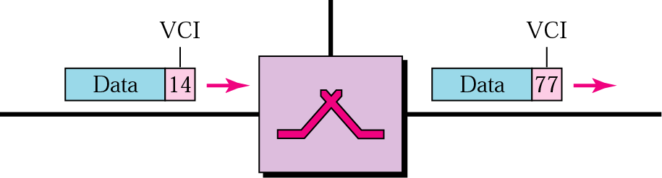
Virtual Circuit Identifier (VCI)
VCI is actually used for data transfer.
VCI (Virtual Circuit Identifier)
  is a small number that only has switch scope,
  it is used by a frame between two switches.
Each switch can use its own unique set of VCIs

Slide 23
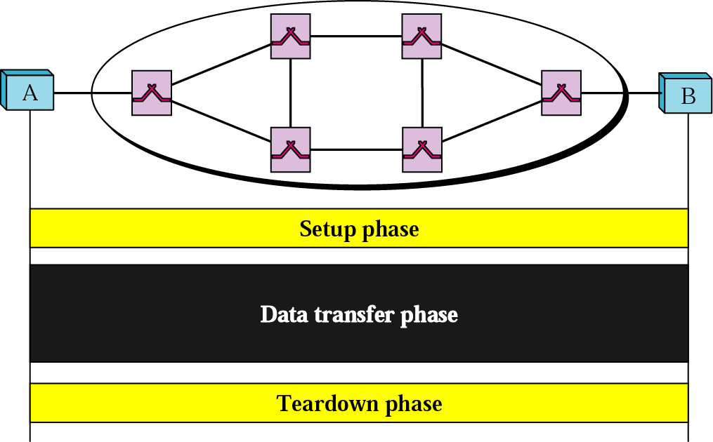
Three Phases
To communicate, a source and destination need to go through three phases
  setup, data transfer, teardown

Slide 24
Three Phases
In the setup phase, the source and destination use their global addresses to help switches make table entries for the connection.
In the teardown phase, the source and destination inform the switches to erase the corresponding entry.
Data phase occurs between these two phases.

Slide 25
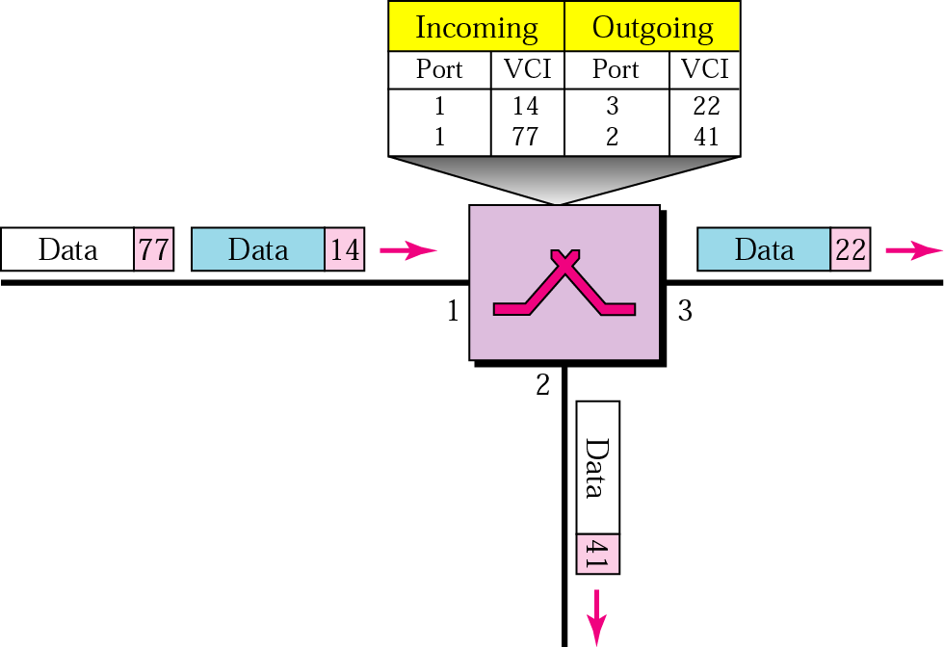
Data Transfer Phase
To transfer a frame from a source to its destination, all switches need to have a table entry for this virtual circuit.

Slide 26
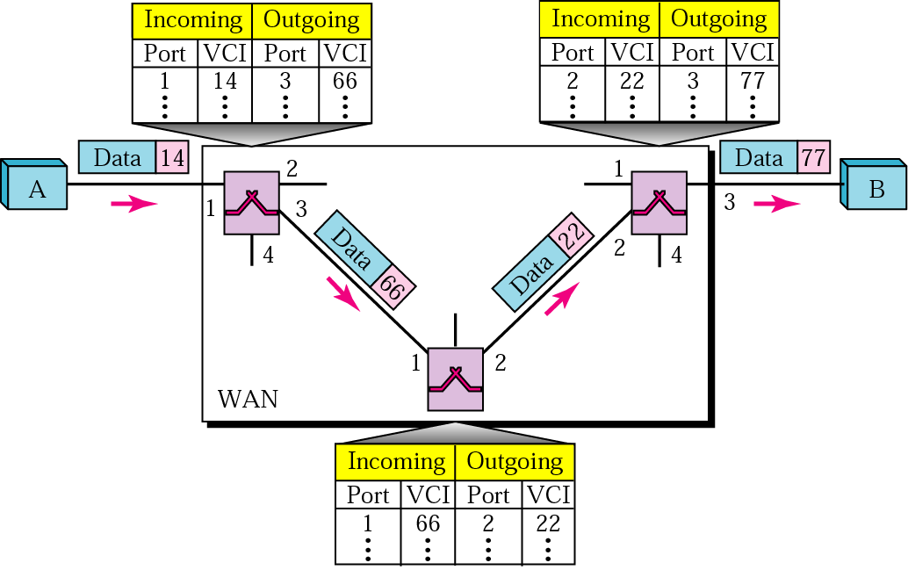
Data Transfer Phase (cont’d)
Source-to-destination data Transfer

Slide 27
Setup Phase
How does a switch create an entry for a virtual circuit?
  Switched virtual circuit (SVC) approach
    Suppose source A needs to create a virtual circuit to B.
    Two steps are required;
      the setup request and the acknowledgment.

Slide 28
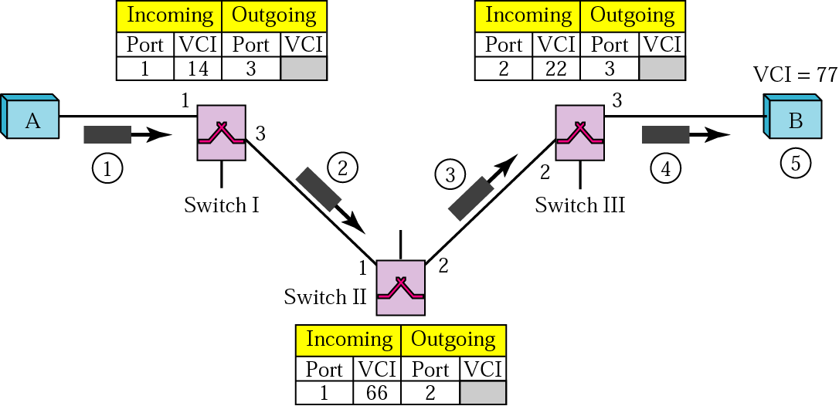
Switched Virtual Circuit (SVC)
Creating temporary and short connection that exists only when data are being transferred between source and destination.
Setup request
VCI (77) lets the destination know that
the frames come from A and not
other sources

Slide 29
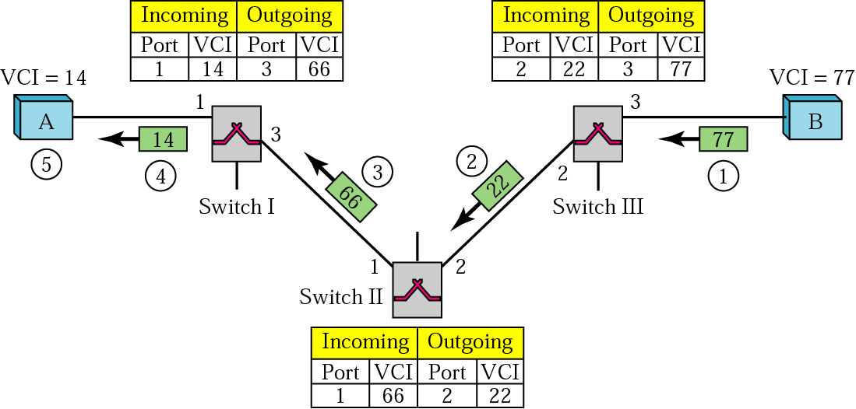
SVC (cont’d)
SVC setup acknowledgment

Slide 30
Teardown Phase
In this phase, source A, after sending all frames to B, sends a special frame called a teardown request.
Destination B responds with a teardown confirmation frame.
All switches erase the corresponding entry from their tables.

Slide 31
Efficiency
Note
In virtual-circuit switching, all packets belonging to the same source and
destination travel the same path;
but the packets may arrive at the destination with different delays
if resource allocation is on demand.

Slide 32

Delay in Virtual-circuit networks
There is a one-time delay for setup and a one-time delay for
teardown.
If resources are allocated during the setup phase, there is no wait
time for individual packets.
Total delay time = 3T + 3 זּ + setup delay + teardown time

Slide 33
Note
Switching at the data link layer in a switched WAN is normally
implemented by using
virtual-circuit techniques.

Slide 34
8.4 STRUCTURE OF A SWITCH
We use switches in circuit-switched and packet-switched networks. In this section, we discuss the structures of the switches used in each type of network.
Topics discussed in this section:
Structure of Circuit Switches
Structure of Packet Switches

Slide 35
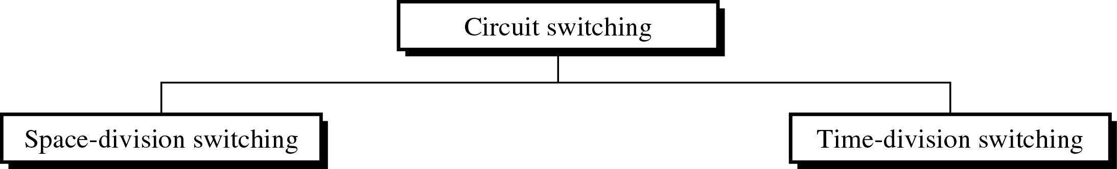
Circuit Switching(cont’d)
Structure of Circuit Switching
~ can use either two technologies.
Switching

Slide 36
Circuit Switching(cont’d)
Space-Division Switches
  the paths in the circuit are separated from each other spatially(crossbar switch)
Crossbar switch
  ~ connect n input to m output in a grid, using electronic microswitch(transistor) at each crosspoint.

Slide 37

Circuit Switching(cont’d)
Figure 8.17 Crossbar switch with three inputs and four outputs

Slide 38
Circuit Switching(cont’d)
Limitation of crossbar switch
  The number of switch (huge size)
  : connect n inputs by m output
    require n * m crosspoint.
  (ex : 1000 input, 1000 output → 1,000,000 crosspoint)
  inefficient
    fewer than 25% of the crosspoints are in use at a given time.
    the rest are idle

Slide 39

Circuit Switching(cont’d)
Multistage switch
  ~ combines crossbar switches in several (normally three) stages to solve the limitation of the crossbar switch.
Figure 8.18 Multistage switch

Slide 40
Circuit Switching(cont’d)
Time-Division Switch
  uses Time-division multiplexing (TDM) inside a switch.
  The most popular technology is called the time-slot
  interchange (TSI).
    TSI changes the ordering of the slots based on the desired connections.

Slide 41
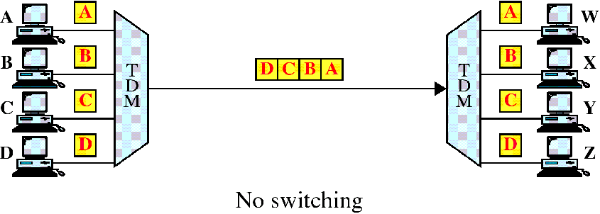
Circuit Switching(cont’d)
Time-division multiplexing without a time-slot interchange(TSI)

Slide 42
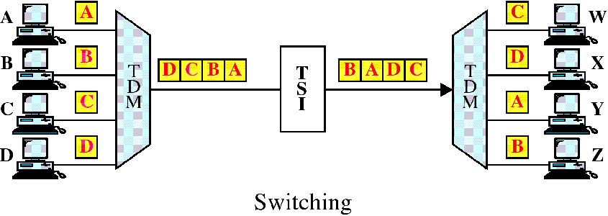
Circuit Switching(cont’d)
Time-division multiplexing with a time-slot interchange(TSI)

Slide 43

Circuit Switching(cont’d)
TSI
Figure 8.19 Time-slot interchange

Slide 44
Circuit Switching(cont’d)
Space-and Time-Division Switching Combinations
  ~ combine space-division and time-division technology to take advantage of the best of both
  TST(time-space-time)
  TSST(time-space-space-time)
  STTS(space-time-time-space)

Slide 45

Circuit Switching(cont’d)
Figure 8.20 Time-space-time switch

Slide 46

Structure of Packet switches
A switch used in a packet-switched network has a different structure from a switch used in a circuit-switched network.
A packet switch has four components;
  input ports, output ports, the routing processor, and the switching fabric.
Figure 8.21 Packet switch components

Slide 47

Structure of Packet switches
Figure 8.22 Input port
An input port performs the physical and data link functions
of the packet switch.

Slide 48

Structure of Packet switches
Figure 8.23 Output port
An output port performs the same functions as the input port,
but in the reverse order.

Slide 49
Structure of Packet switches
Routing Processor
  The routing processor performs of the network layer.
Switching fabrics
  The most difficult task in a packet switch is to move the packet
  from the input queue to the output queue.
  Today, packet switches are specialized mechanisms that use
  a variety of switching fabrics.
    Crossbar switch : Simplest type of switching fabric is the
    crossbar switch.

Slide 50

Structure of Packet switches
Figure 8.24 A banyan switch
A banyan switch is a multistage switch with microswitches at each stage that route the packets based on the output port represented as a binary string.

Slide 51

Structure of Packet switches
Figure 8.25 Examples of routing in a banyan switch

Slide 52

Structure of Packet switches
Figure 8.26 Batcher-banyan switch
Batcher-banyan switch has designed to solve the problem of banyan switch that comes before the banyan switch and sorts the incoming packets according to their final destination.

Slide 53
Summary (1)
A switched network consists of a series of interlinked nodes, called switches; circuit switching, packet switching, and message switching.
We can divide today’s networks into three broad categories: circuit-switched networks, packet-switched networks, and messaged-switched. Packet-switched networks can also be divided into two subcategories: virtual-circuit networks and datagram networks.
A circuit-switched network is made of a set of switches connected by physical links. In circuit switching, the resources need to be reserved during the setup phase; the resources remain dedicated for the entire duration of data transfer phase until the teardown phase
In packet switching, there is no resource allocation for a packet. This means that there is no reserved bandwidth on the links, and there is no scheduled processing time for each packet. Resourced are allocated on demand.

Slide 54
Summary (2)
In a datagram network, each packet is treated independently of all others. Packets in this approach are referred to as datagrams, There are no setup or teardown phases.
A virtual-circuit network is a cross between a circuit-switched network and a datagram network. It has some characteristics of both.
Circuit switching uses either of two technologies: the space-division switch or the time-division switch.
A switch in a packet-switched network has a different structure from a switch used in a circuit-switched network. We can say that a packet switch has four types of components: input ports, output ports, a routing processor, and switching fabric.

Slide 55

Q & A

